Slide 1
Embedded Systems Lab 4
Aymen Bahroun, Thales Mendes Sampaio, Abhi Kamboj & Aurélien Morel

Slide 2
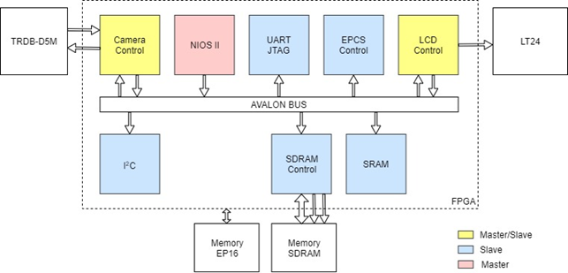
FPGA Architecture

Slide 3
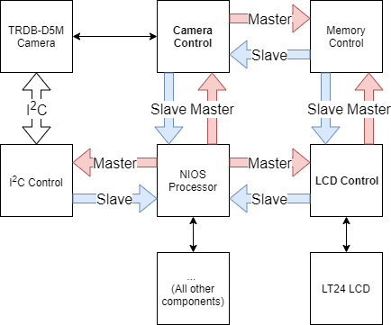
Avalon Master-Slave Relations

Slide 4
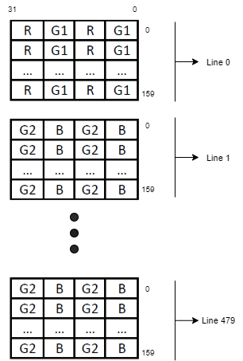
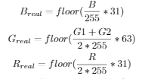
Memory Map
First LCD Pixel
640x480 pixels from Camera
Row-major order
32 bit addressability
each address space holds 4 consecutive pixels, so 160 address spaces represents a full row (160*4=640)

Slide 5
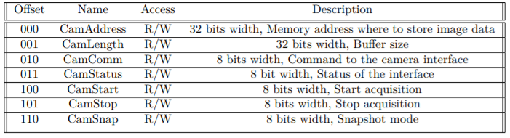
Camera Register Map

Slide 6
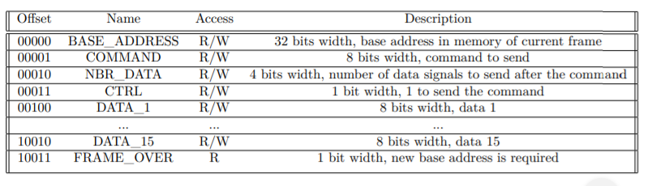
LCD Register Map

Slide 7
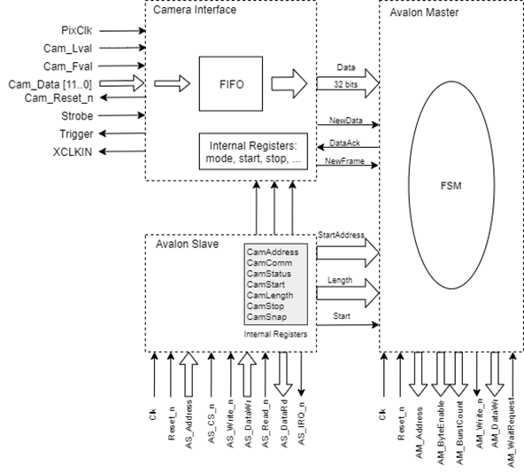
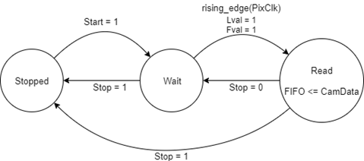
Camera
Interface
FIFO: 8 bit input -> 32 bit output

Slide 8
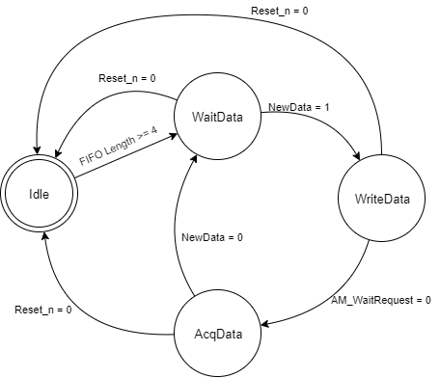
Master Concept: Camera
Rdusedw > 0
1

Slide 9
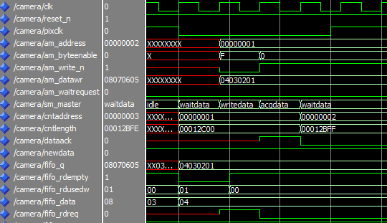
Master Access: Camera Interface
Notes:
FIFO

Slide 10
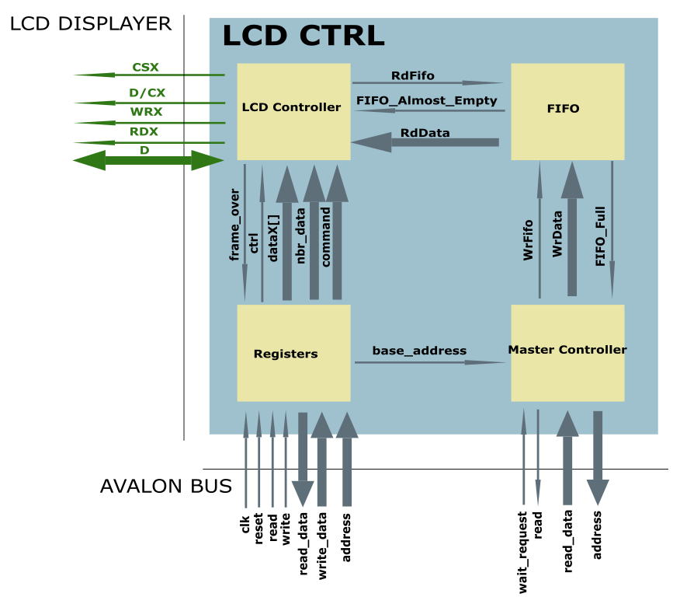
LCD Interface

Slide 11
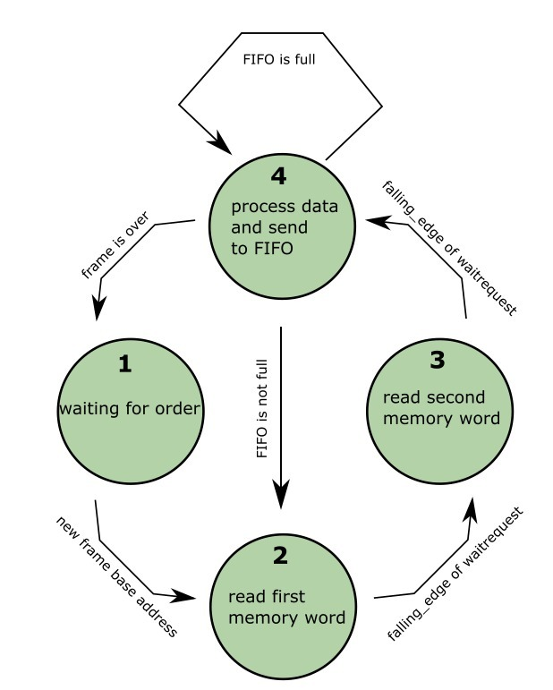
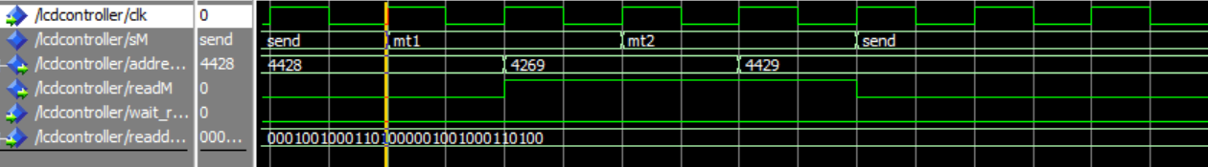
Master Access: LCD

Slide 12
Final Results
Registers can be set correctly by the Avalon Slave
Simulation on ModelSim successful
Errors during configuration of camera and LCD

Slide 13
Thank you!
Questions ?

